Slide 1


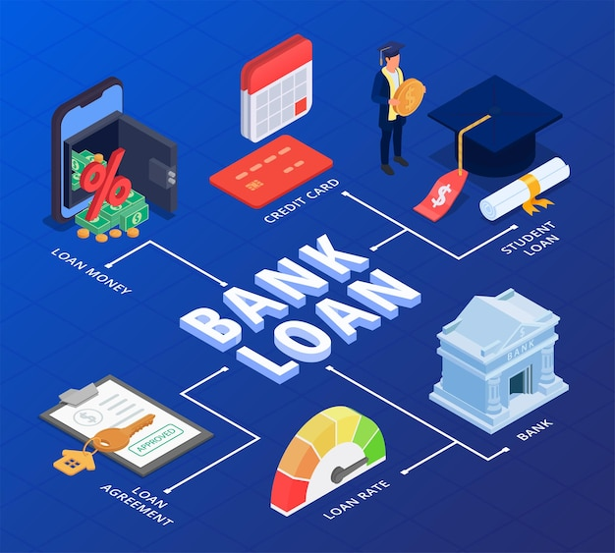
Bank Loan of Customers | Finance Data Analyst
Mentor : Bidhan Sen
Group no : 3
Group Members :
Goutam Kuiri
Indira Mulage
Rohith J
Meshak J
Pratik Patade
Sristi Kulkarni
Sneha

Slide 2
Project Objective
This is Bank loan of Customers project where we were provided with 2 datasets with .csv and .xlsx extension files having 39k rows each and the objective was to analyze the growth that bank got within given years in loans.
We used MS-Excel for analyzing, cleaning and removing duplicates from dataset and prepared dashboard using MS-Excel tools where we did calculations with pivot table , merging and prepared interactive dashboards.

Slide 3
Contents
KPI-1 : Year wise loan amount Stats
KPI-2 : Grade and sub grade wise revol_bal
KPI-3 : Total Payment for Verified Status Vs Total Payment for Non Verified Status
KPI-4 : State wise and last_credit_pull_d wise loan status
KPI-5 : Home ownership Vs last payment date stats

Slide 4
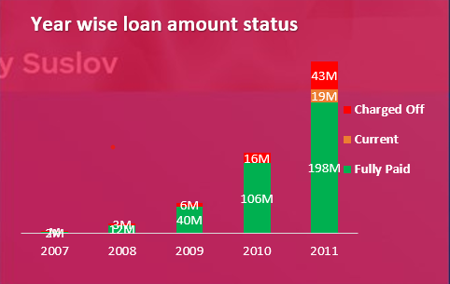
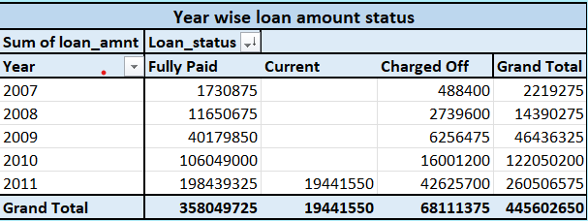
KPI-1
Year wise loan amount Stats :
By observing the chart we can see how Loan Amount is increasing by year.
Starts from 2007 the loan amount is 22,19,275 and in the 2011 the loan amount is 26,05,06,575. We can subtract the new value to the old value to see the difference
26,05,06,575 - 22,19,275 = 258287300
258287300 increased in the duration of 4 years
And Grand Total of all years is 44,56,02,650.00

Slide 5
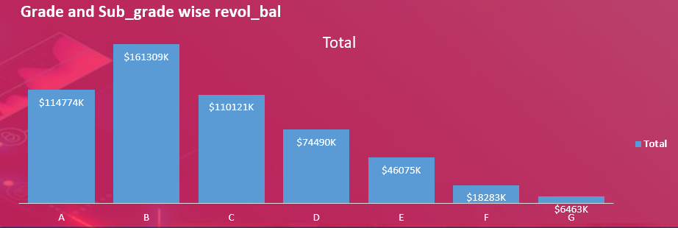
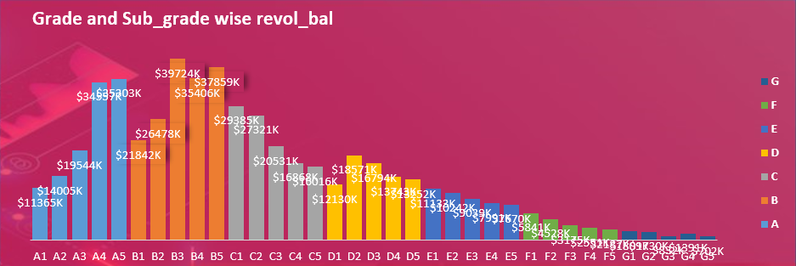
KPI-2
Grade and sub grade wise revol_bal :
In this Grade and subgrade wise revol balance we can notice Grade-B have more revol balance then any other grade & Grade-G have very low revol balance.
As we can see that Grade B customers has higher annual income for 10+ yrs of employment period, so higher the annual income lower the Debt to income ratio and hence, more number of customers took loan in Grade B .
Similary, it goes for other grades also B>A>C>D>E>F>G order for revol bal as per annual income

Slide 6
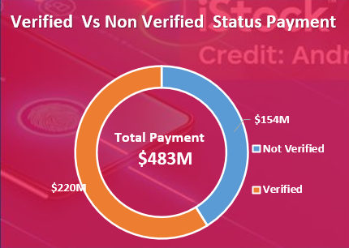
KPI-3
Total Payment for Verified Status Vs Non Verified Status :
This is the first stage of the verification process. The bank needs a loan application to initiate the document collection and verification process
Looking at Doughnout chart we can observe that verified status have $220M of total payment and $154M of total payment which are Not Verified for the Loan Amount

Slide 7
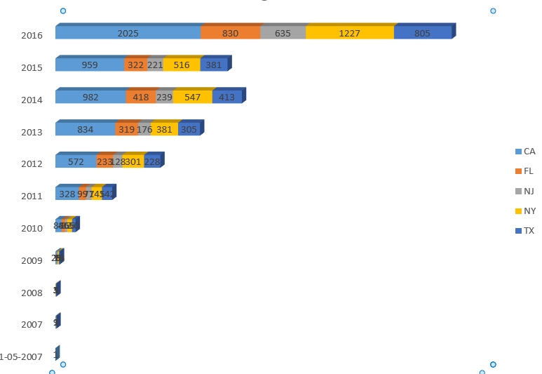
KPI-4
The graph above shows the Top 5 states to whom bank gave the highest amount of Loan.
Here , it is clearly seen that in top 10 states, CA has given highest amount of loan to customers and lowest is MA. But, maximum of customers in each state has fully paid status followed by Charged off and current.

Slide 8
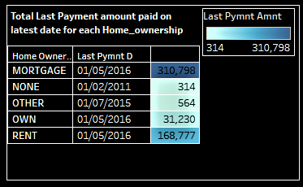
KPI-5
Home_ownership versus last payment date stats insights:
The right graph shows the Home ownership and the amount paid for each on last payment date.
Here, we can see that maximum latest amount paid by customers with MORTGAGE home ownership is Rs.310,798.
It concludes that many of the customers are about to repay their loan amount for their particular home ownership.

